Slide 1
Topic 3.5 –Mole Concepts: Part 1
Unit 1

Slide 2
Vocab List
molar mass
mass
mole
Avogadro’s Number
concentration
volume

Slide 3
Learning goal
Topic 3.3: Mole concept and law of conservation of mass
State that a mole is a precisely defined quantity of matter equal to Avogadro’s number of particles.
State the law of conservation of mass.
Explain that the mole concept relates mass, moles and molar mass.
Apply the mole concept to calculate the mass of reactants and products; amount of substance in moles; number of representative particles; and molar mass of atoms, ions, molecules and formula units. (Formula: moles (𝑛𝑛) = mass (m) molar mass (M) )

Slide 4
The next few weeks……
Quantitative = measureable (like with numbers)
We’re shifting our study to stoichiometry:
The study of quantitative aspects of formulae and equations
Based on the Law of Conservation of Mass – Mass cannot be created or destroyed by physical changes or chemical reactions.
i.e. the mass of reactants equals the mass of products.

Slide 5
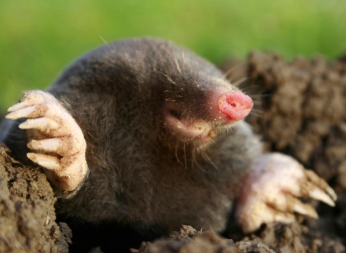
Moles?
A mole is a unit of measurement. It is a measure of the number of particles
Defined as the amount of substance that contains as many elementary particles (atoms, molecules or ions) as there are atoms in exactly 12g of the carbon-12 isotope.
12 g of C-12 contains 6.02 x 10²³ atoms. This is known as Avogadro’s number.
A mole of a substance weighs the same as the atomic or molecular mass in grams.

Slide 6
Atomic vs molecular mass
Relative Atomic Mass (Atomic Mass)
Relative Molecular Mass (Molecular mass)
A_{r}
The average mass of the atoms present in the naturally occurring element relative to the mass of an atom of the carbon-12 isotope taken as exactly 12
NB: a relative mass; no units
M_{r} - covalent and metallic molecules
The mass of a molecule of the compound relative to the mass of an atom of the carbon-12 isotope taken as exactly 12
The molecular weight of a compound is the sum of the atomic masses of the atoms as given in the molecular formula
NB: a relative mass; no units

Slide 7
Calculating Molecular mass
M_{r} (CO₂) = 12.0 + (2 x 16.0)
= 44.0
We aren’t going to use this too much, because we need to be very precise for the calculations we’re going to start doing.
We’re going to focus on the molar mass
Notice that we don’t use the R.A.M, which for carbon is 12.01.
Molecular mass is based off the number of neutrons and protons, so we will only use whole numbers

Slide 8
Molar Mass
Molar mass is the mass required to have 1 mole of an atom/molecule
For this we will use their exact R.A.M
E.g. Molar mass of NaOH:
22.99 + 16 + 1.01 = 40 g/mol
Molar mass of Au(NO₃)₂:
(196.97) + (14.01x2) + (16x6) = 320.99 gmol⁻¹
The unit is g/mol (the number of grams per mole)
This means everything in the brackets is doubled
You might also see it written like this

Slide 9
The mole - examples
A mole of lead (Pb – atomic weight 207.02) is 207.02 grams
A mole of water (molecular weight 18.02) is 18.02 grams
A mole of lead has 6.02 x 10²³ atoms
A mole of water has 6.02 x 10²³ molecules

Slide 10
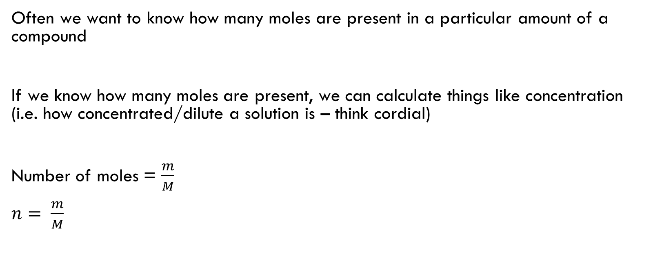
Converting mass to moles
Often we want to know how many moles are present in a particular amount of a compound
If we know how many moles are present, we can calculate things like concentration (i.e. how concentrated/dilute a solution is – think cordial)
Number of moles = $\frac{m}{M}$
$n= \frac{m}{M}$
m = mass (grams)
M = molar mass (g/mol)
n = moles (all the m’s were taken, so we use n)

Slide 11


Sample Problem
A solution of salt water contains 23 g of NaCl. How many moles of salt are present?
$$n= \frac{m}{M}$$
n = ?
m = 23 g
M = (22.99 +35.45)
= 58.44 g/mol
$$n= \frac{23}{58.44}$$
$n=$0.39 moles

Slide 12
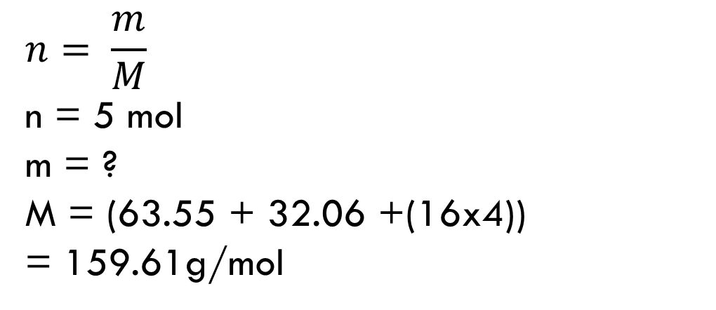

Sample Problem
Jono wants to add 5 moles of CuSO₄ so a beaker of water. How many grams will he need to add?
$$n= \frac{m}{M}$$
n = 5 mol
m = ?
M = (63.55 + 32.06 +(16x4))
= 159.61g/mol
$$5= \frac{m}{159.61}$$
$$5×159.61=m$$
$$m=798.05 g$$

Slide 13
To Solve
Calculate the amount, in moles, of:
46 g of water, H₂O = 2.553 mol
67 g of chlorine gas, Cl₂ = 0.945
38 kg of iron (III) oxide, Fe₂O₃ = 237.966
Calculate the mass of:
2 moles of lead (II) nitrate, Pb(NO₃)₂ = 662.416 g
1.35 moles of ethanol, C₂H₆O =62.192 g
1 mole of xenon hexafluoride, XeF₆ = 245.278 g

Slide 14
Converting moles to number of atoms or molecules
Number of atoms or molecules = Number of moles x Avogadro constant
= Number of moles x (6.02 x 10²³)

Slide 15
Sample Problem
A gas balloon contains 5.5 mol of Helium atoms. How many Helium atoms are present?
Number of particles
= Moles of helium x 6.02 x 10²³
= 5.5 x 6.02 x 10²³
= 3.3 x 10²⁴ atoms of helium

Slide 16
To Solve
Calculate the number of chlorine atoms or chloride ions in:
2.3 mol of chlorine atoms
15.8 mol of chlorine molecules, Cl₂
3.5 mol of sodium chloride, NaCl
0.5 mol of magnesium chloride, MgCl₂

Slide 17
To Solve
Calculate the mass of 3.84 mol of sucrose, C₁₂H₂₂O₁₁.
What is the mass of 4.13 x 10²⁸ molecules of carbon disulfide, CS₂?
Calculate the number of moles of each of the following particles present in
5.2 x 10²⁴ molecules of methane:
a) methane molecules
b) carbon atoms
c) hydrogen atoms.

Slide 18

Calculating moles from concentration and volume
Concentration units
mol/L = M
Volume Conversions
1L = 1000 mL = 1000000 µL
1L = 1 dm³ = 1000 cm³
Concentration = moles / volume
$c=\frac{n}{v}$
$c_{1}v_{1}=c_{2}v_{2}$

Slide 19
Sample problem
Calculate the moles of NaCl in 0.5L of a 1.5 mol/L solution.

Slide 20
To solve
Calculate the moles in 5L of 3.5 mol/L of sucrose, C₁₂H₂₂O₁₁.
Calculate the number of molecules of iron (II) chloride in 200mL of a 0.6 mol/L solution?
Calculate the number of moles in each of the following solutions:
a) 1.2L of 1 mol/L nitric acid.
b) 424 mL of 1.8 mol/L hydrochloric acid.
Calculate the mass in grams of sodium hydroxide that is needed to make 1L of a 2 mol/L solution.
500mL of water was added to 250 mL of a 3 mol/L copper (II) sulfate solution. Calculate the new concentration of copper (II) sulfate.

